Slide 1

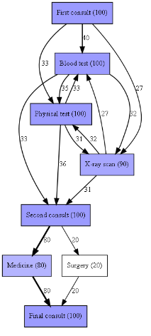
Process Mining to Generate Healthcare Pathways
Alexander Coles

Slide 2
Content
What is Process Mining?
The PM² framework + Clearpath
Process Mining in Healthcare Literature
Project with East Midlands Ambulance Service

Slide 3
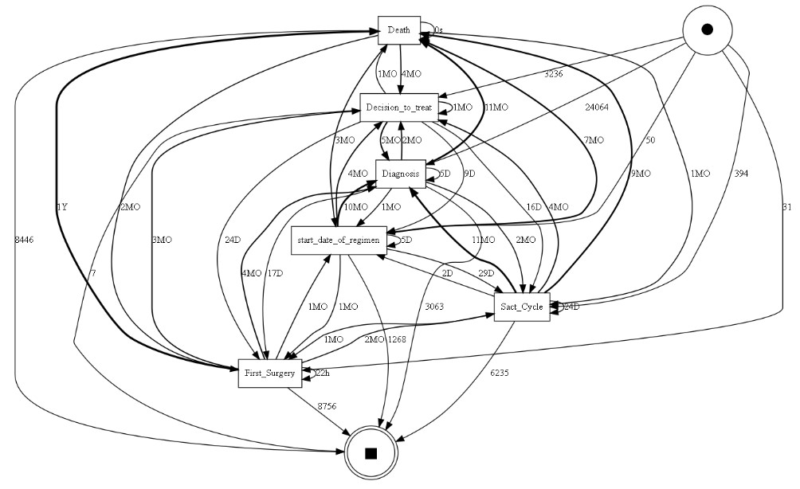
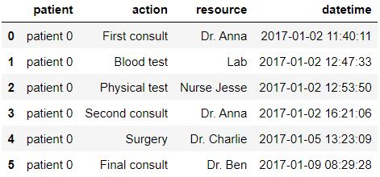
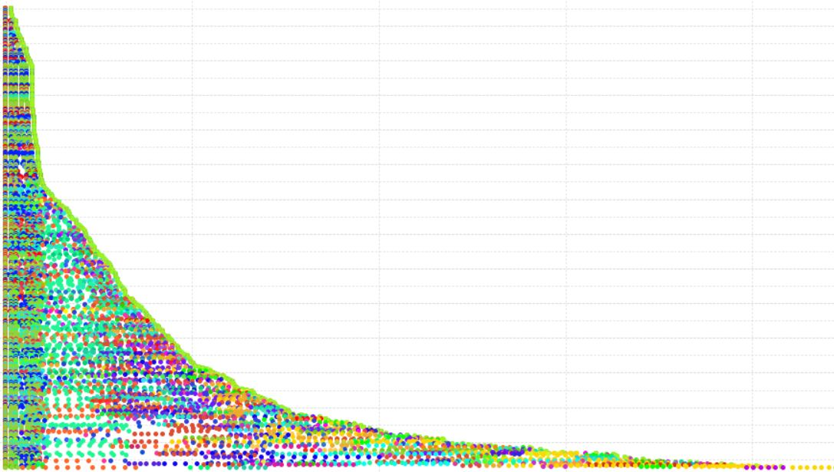
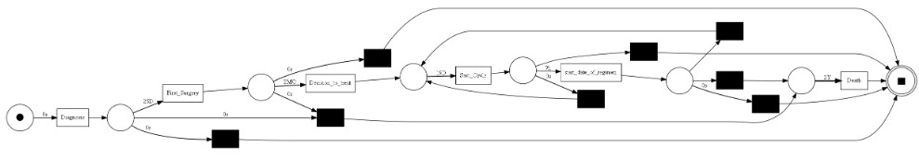
What is Process Mining?
Patient Activity Resource Timestamp
A tool to visualise and analyse business processes
Patients
Time Since Start of Case

Slide 4
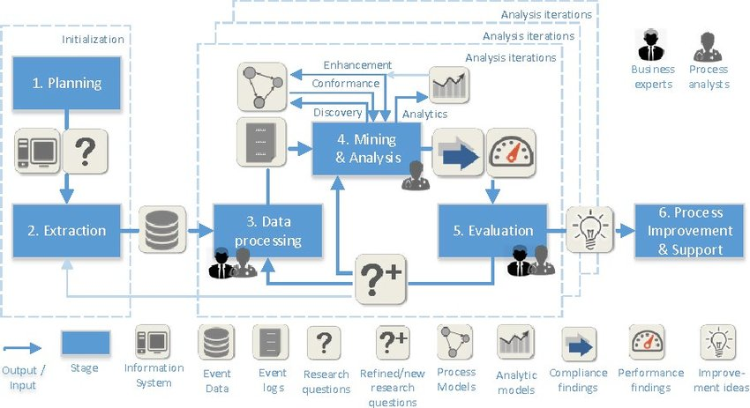
PM² Process Mining Pathway and Clearpath
Planning
PM^{2[1]}
Identify research questions
Compose project team: business experts, process analysts.
Clearpath^{[2]}
Research questions are often simply “what is the care pathway?” or “what does it look like?
Project team includes identifying a Clinical Review Board.

Slide 5
PM² Process Mining Pathway and Clearpath
Extraction
PM^{2[1]}
Determine Scope with data. Looking at granularity, timeperiod, data attributes.
Extract Event Data
Knowledge of process exchanged between business experts and process analysts.
Clearpath^{[2]}
Ethics of extracting sensitive health data often mean long lead times
Transfer process knowledge with meticulous record keeping

Slide 6
PM² Process Mining Pathway and Clearpath
Data Processing
PM^{2[1]}
Creating views: Case focused, resource focused
Aggregating events
Enriching logs. Include additional attributes, age, weather, sex etc
Filtering logs
Clearpath^{[2]}
Filter logs to just include the patients of interest

Slide 7
PM² Process Mining Pathway and Clearpath
Mining and Analysis
PM^{2[1]}
Process Discovery: return a fact-based process model as output.
Conformance Checking: Measure event logs conformance to a process pathway.
Enhancement: extending or improving an existing process model using information about the actual process in an event log.
Clearpath^{[2]}
Examine different scenarios (e.g. weekends vs weekdays)

Slide 8
PM² Process Mining Pathway and Clearpath
Evaluation
PM^{2[1]}
Diagnose: Interpret the results, distinguishing unexpected results from the expected ones, identify research questions for further iterations
Verify Validate
Clearpath^{[2]}
End of each analysis iteration and takes the form of a Clinical Review Board (CRB) meeting.
Plan objectives for the next iteration.

Slide 9
PM² Process Mining Pathway and Clearpath
Process Improvement and Support
PM^{2[1]}
Actual implementation of process changes is generally a separate project and a different area of expertise.
Results of a process mining project form the fact-based input of process improvement efforts.
Clearpath^{[2]}
Acceptance of the models and evidence by the Clinical Review Board for implementing improvements.

Slide 10
Literature
Process Discovery
Conformance
Evaluation

Slide 11
Literature
Process Discovery
Baker, K. et al. (2017), ‘Process mining routinely collected electronic health records to define real-life clinical pathways during chemotherapy’, International journal of medical informatics 103, 32–41.
Out of 535 breast cancer patients only 5% completed the planned six cycles of chemotherapy without having unplanned hospital contact. Over the six cycles 31.6% patients were admitted to hospital.
Kurniati, A. P. et al. (2021), ‘Process mining to explore variations in endometrial cancer pathways from gp referral to first treatment’.
~50% of patients took <= 62 days (the expected duration) from referral to diagnosis
Williams, S et al. (2022), ‘To the emergency room and back again: Circular healthcare pathways for acute functional neurological disorders’, Journal of the Neurological Sciences 437, 120251.
“People that present acutely to a UK city hospital with functional neurological disorders tend to follow looping pathways through hospital healthcare events, centered around ED, with low rates of documented diagnosis and referral for psychological therapy.”

Slide 12
Literature Continued
Conformance
Kurniati, A. P. et al. (2019), A multi-level approach for identifying process change in cancer pathways, in ‘International Conference on Business Process Management’, Springer, pp. 595–607.
Analysed process changes using yearly conformance to a general process model
Puthur, C et al (2022), Measuring the impact of covid-19 on hospital care pathways, in ‘International Conference on Process Mining’, Springer,pp. 391–403.
“During the pandemic, both A&E and maternity pathways had measurable reductions in the mean length of stay and a measurable drop in the percentage of pathways conforming to normative models”
Enhancements
Quintano Neira, R. A. et al. (2019), Analysis and optimization of a sepsis clinical pathway using process mining, in ‘International conference on business process management’, Springer, pp. 459–470.
Identified, two bottlenecks, and differences in performance in cases that deviated from the prescribed clinical pathway. Were able to suggest optimization points in the sepsis clinical pathway.

Slide 13


Slide 14

EMAS Progress/Targets
Focus
Process Discovery
Category 2
Subcategory, cardiovascular, respiratory etc
Highest Qualification on scene
Time on Scene and Hospital Handover
Conformance
Look for changes in process path based on time, incident, qualification etc
Job Cyle from Public Services Committee (2023), ‘Emergency healthcare: a national emergency.’, https://committees. parliament.uk/publications/33569/documents/187215/default/[Accessed 25 September 2023

Slide 15
Process Discovery with EMAS
All Category 2
Business Rules Applied
Filter by Outcome, Clinical Category, Highest Qualification on Scene etc.

Slide 16
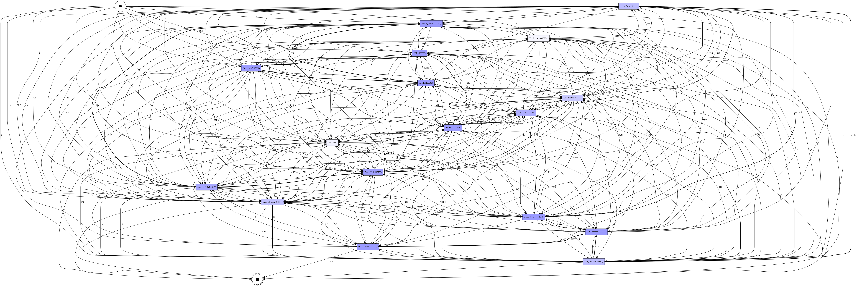
All Category 2
Every Trace Variant for Category 2 Data

Slide 17
Business Rules
Some timestamps are not automatically recorded, allowing some human error in recording.
We constructed business rules with our clinical experts to ensure that we focus on cases where key events are recorded in the expected chronological order

Slide 18
Business Rules – Remove Cases with Missingness
Filtered to Only Including Category 2 we originally had 152,525 patients:
Lost 528 Patients to Business Rules
Remaining Patients after removing patients that don’t follow rules 151,997

Slide 19
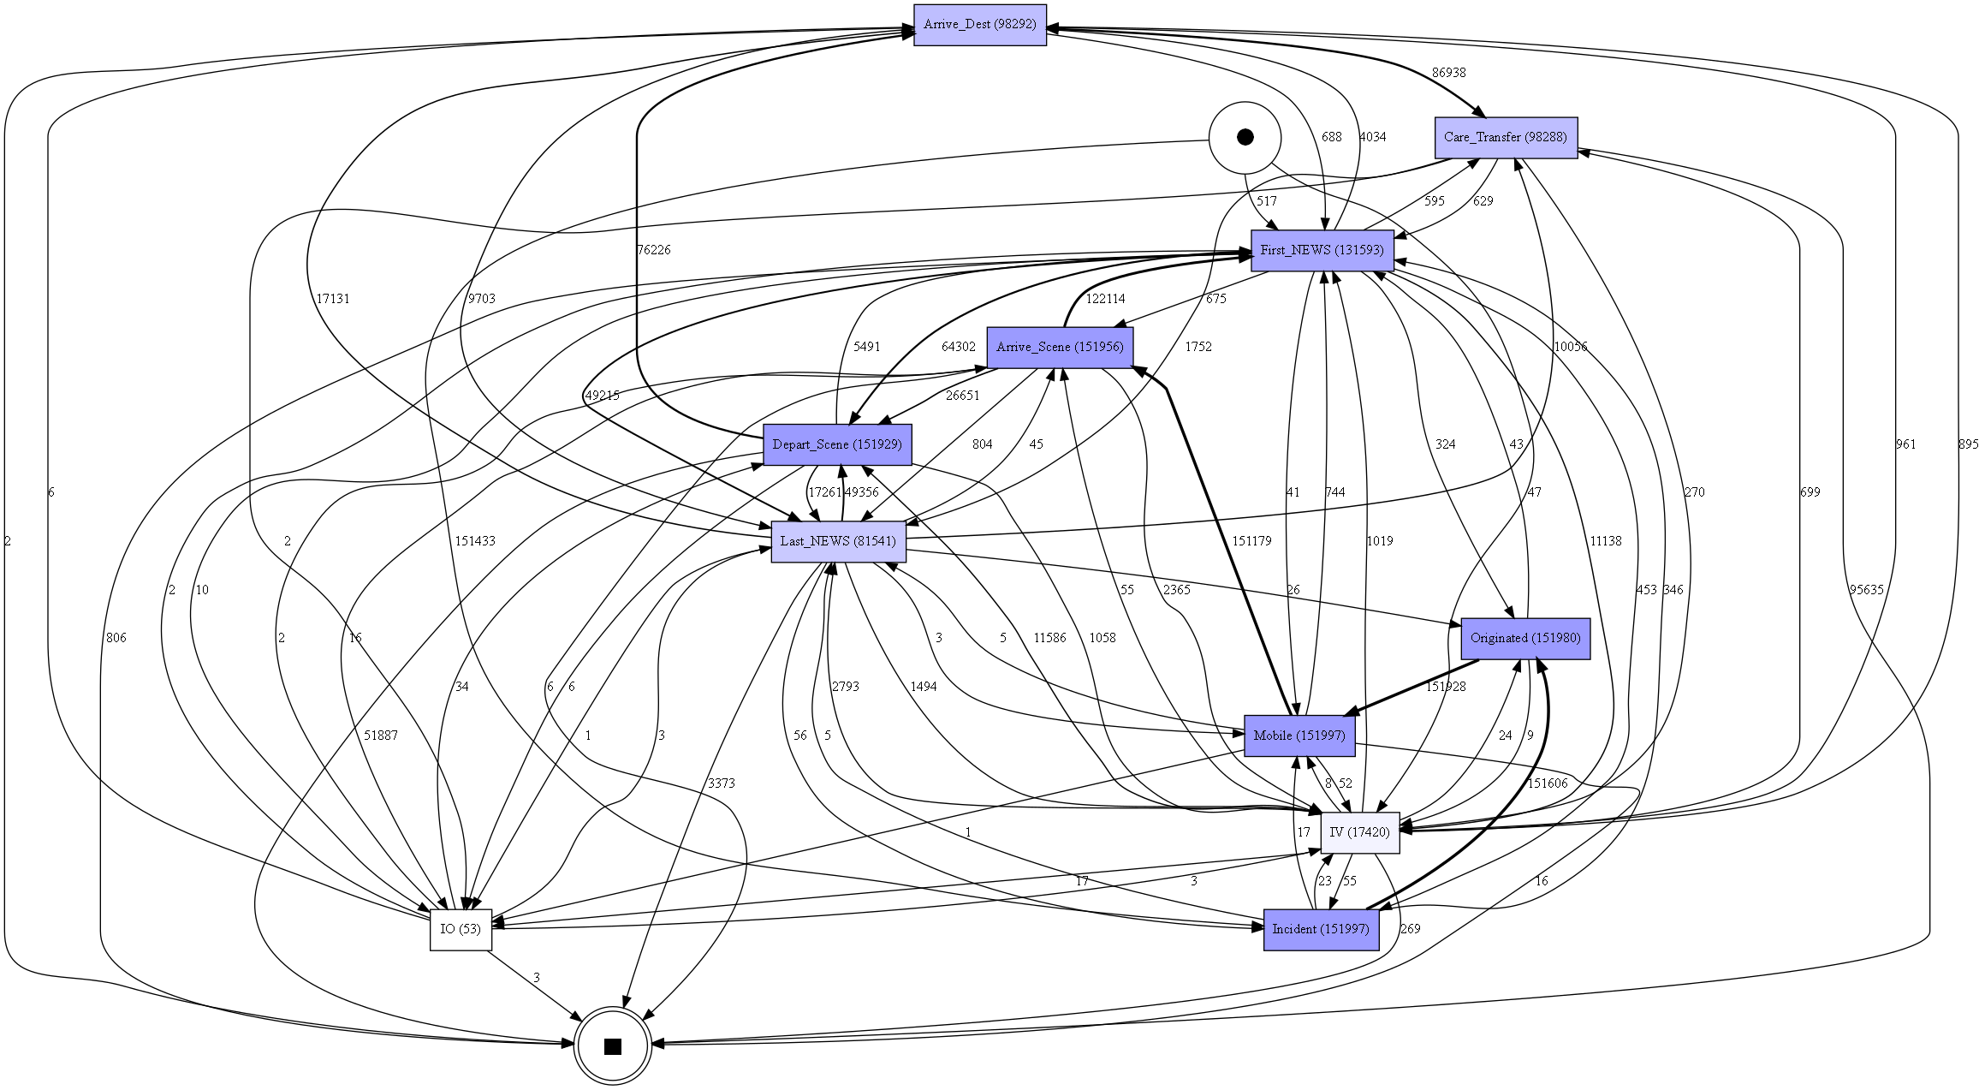
Business Rules Applied

Slide 20
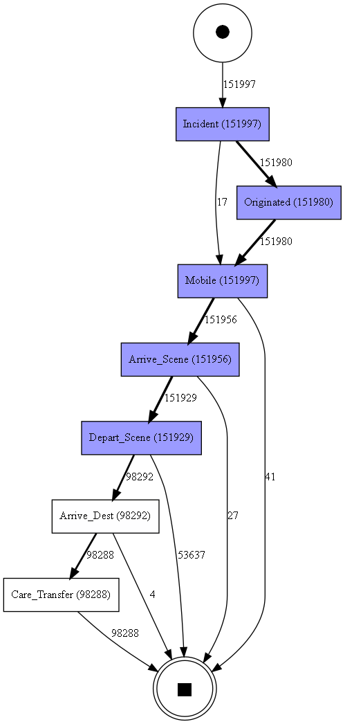
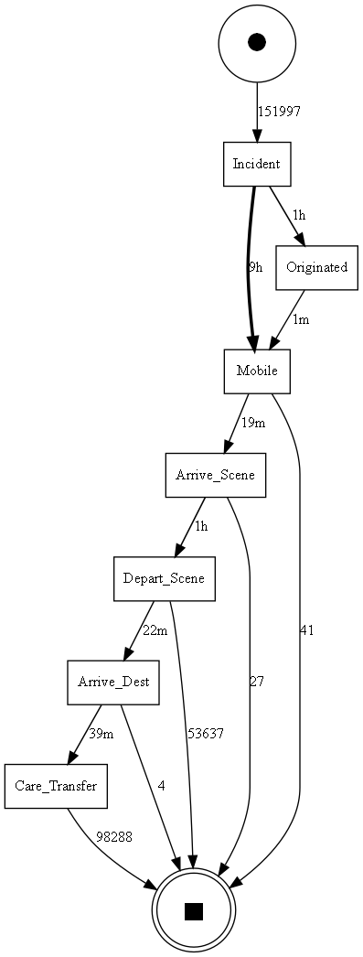
Remove “Optional” Events
8 Variants
~64% follow Incident_Originated_Mobile_Arrive_Scene_Depart_Scene_Arrive_Dest_Care_Transfer
~35% follow Incident_Originated_Mobile_Arrive_Scene_Depart_Scene
Removed
Event | Definition
PCR | Creation of Patient Care Record
DW Inserted | Changes and Updates to the record
DW Updated | Changes and Updates to the record
First NEWS | First National Early Warning Score taken
LAST NEWS | Last National Early Warning Score taken
GCS | Glasgow Coma Scale
RL Pre Alert | Pre Alert for the Emergency Department to alert of their soon arrival
Drug Therapy | Details of Drugs Provided
IV | Intravenous Drug
IO | Intravenous Drug

Slide 21
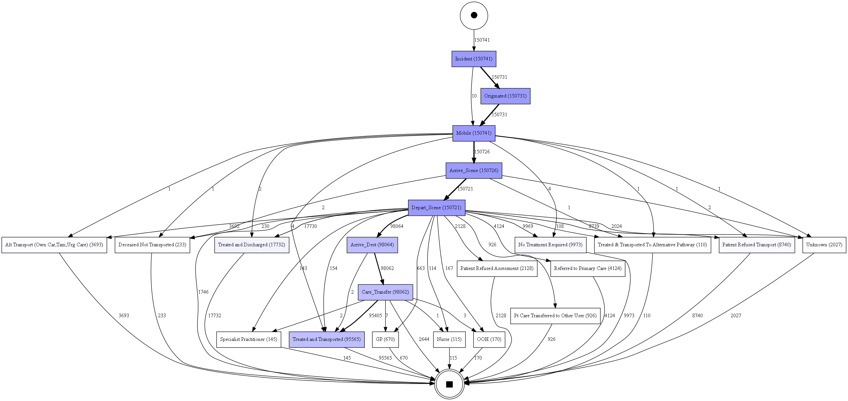
Add Outcome As Events

Slide 22
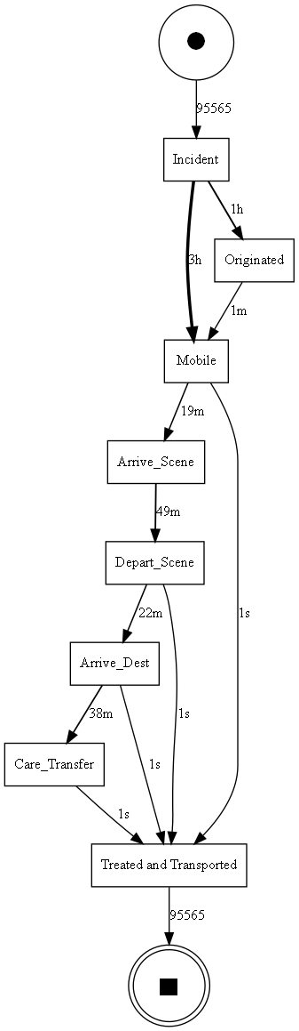
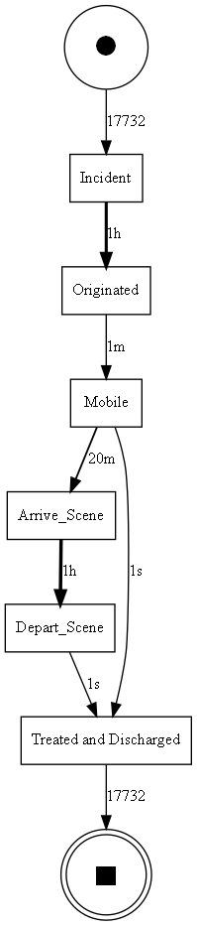
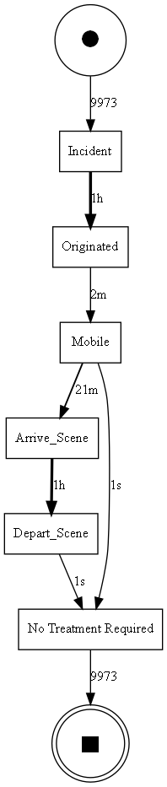
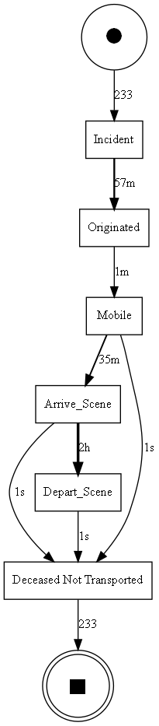
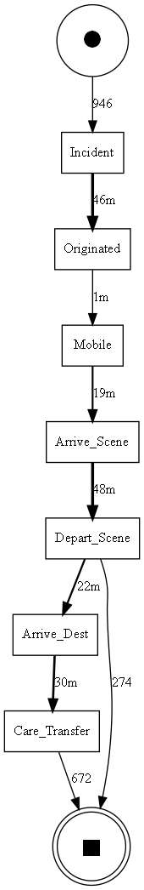
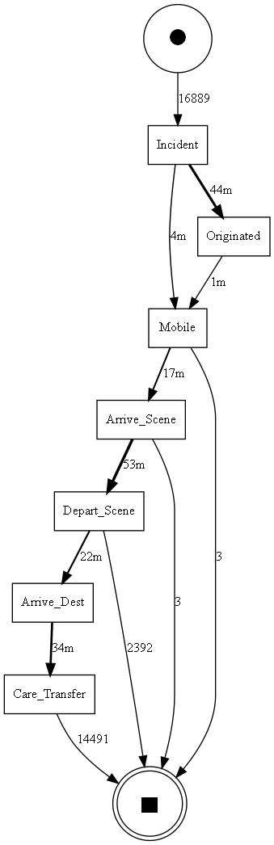
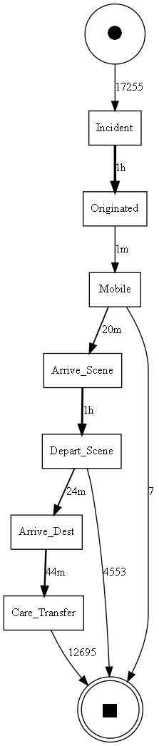
Filter by Outcome or by Category
Treated &
Transported
Treated &
Discharged
No Treatment
Required
Deceased
Not Transported
Obs/Gynae
Cardiovascular
Trauma

Slide 23
Conformance
Expected Trace
Conformance of Raw Data to expected trace
Lowest Fitting Traces
Process Mining Algorithms
Concept Drift

Slide 24
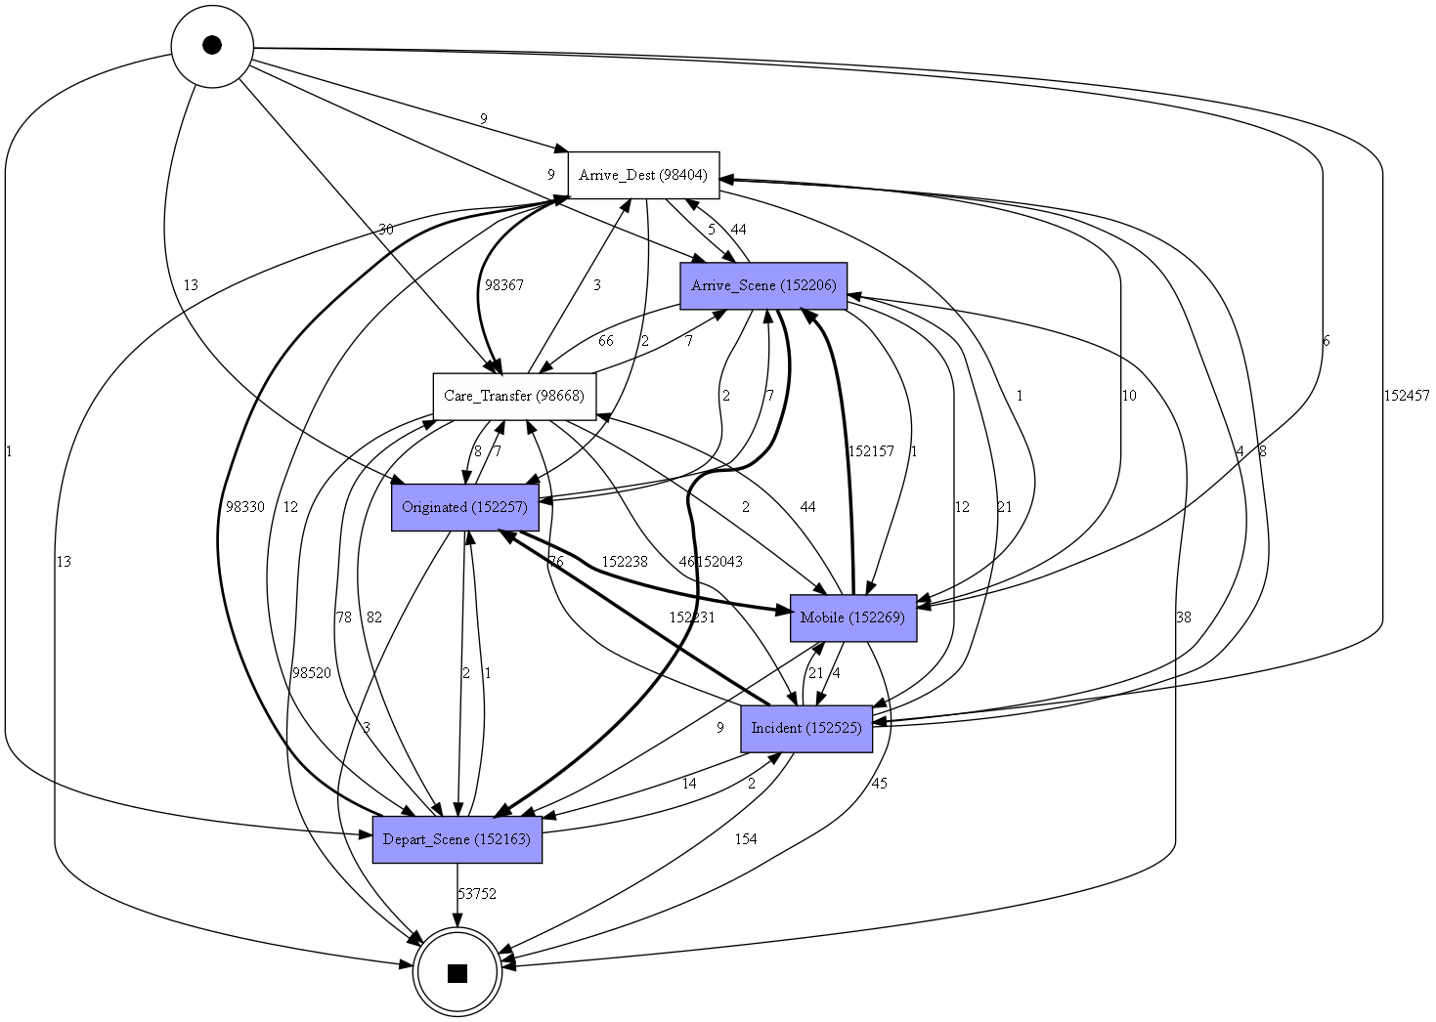
Conformance of Raw data to an “expected trace”
Directly Follows Graph of raw data with non-essential events removed
Percentage of Fitting Traces: 99.48%
Average Trace Fitness: 99.89%
Petri Net of Data with business rules applied and non-essential events removed

Slide 25
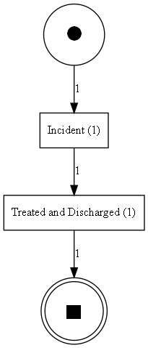
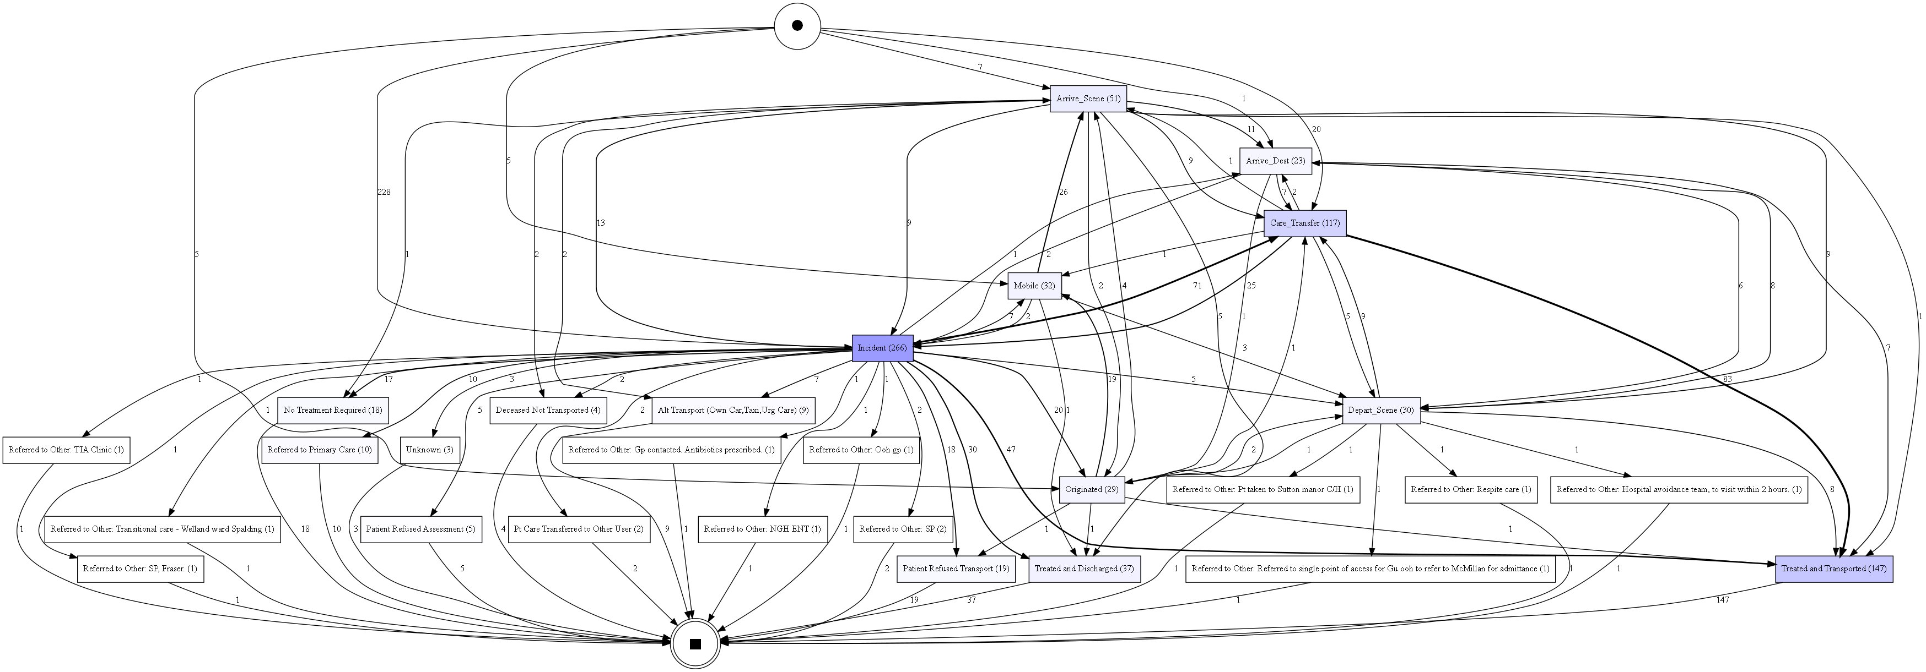
Poorly Conforming Traces
Poorest Fitting Trace Fitness: 0.65
Traces with a Fitness <=80%

Slide 26
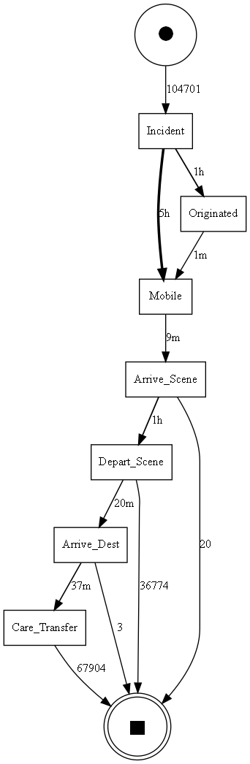
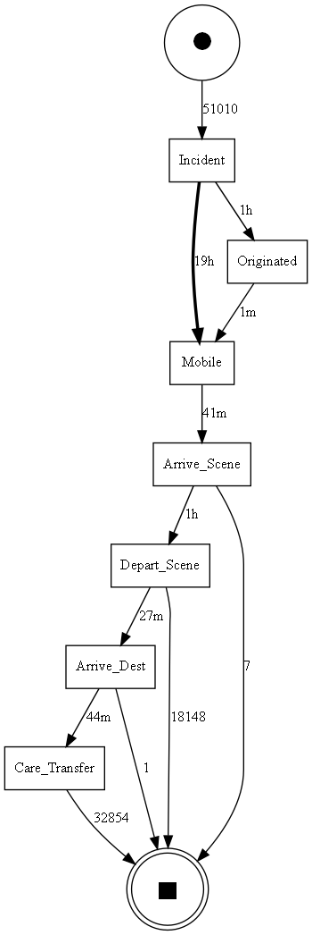
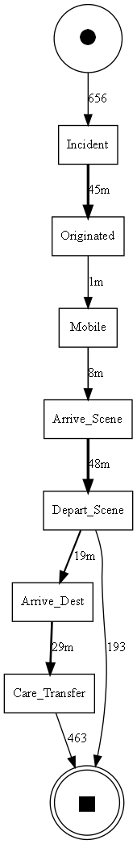
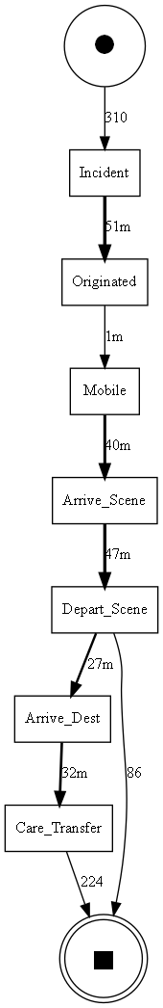
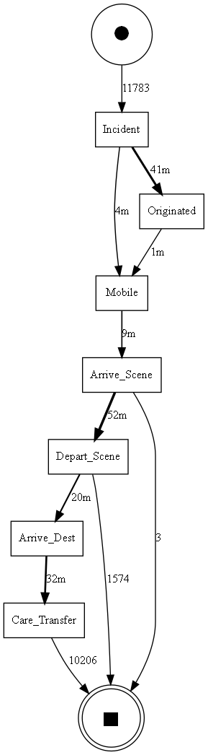
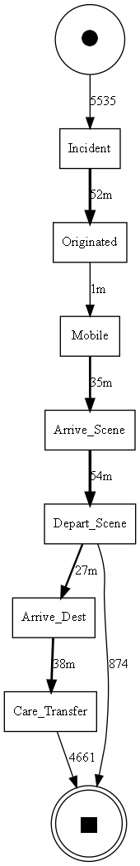
Meeting the Target Time to Arrive on Scene
All cases
<=18 minutes >18m minutes
Obs/Gynae
<=18 minutes >18m minutes
Cardiovascular
<=18 minutes >18m minutes
67%
33%
68%
32%
68%
32%

Slide 27
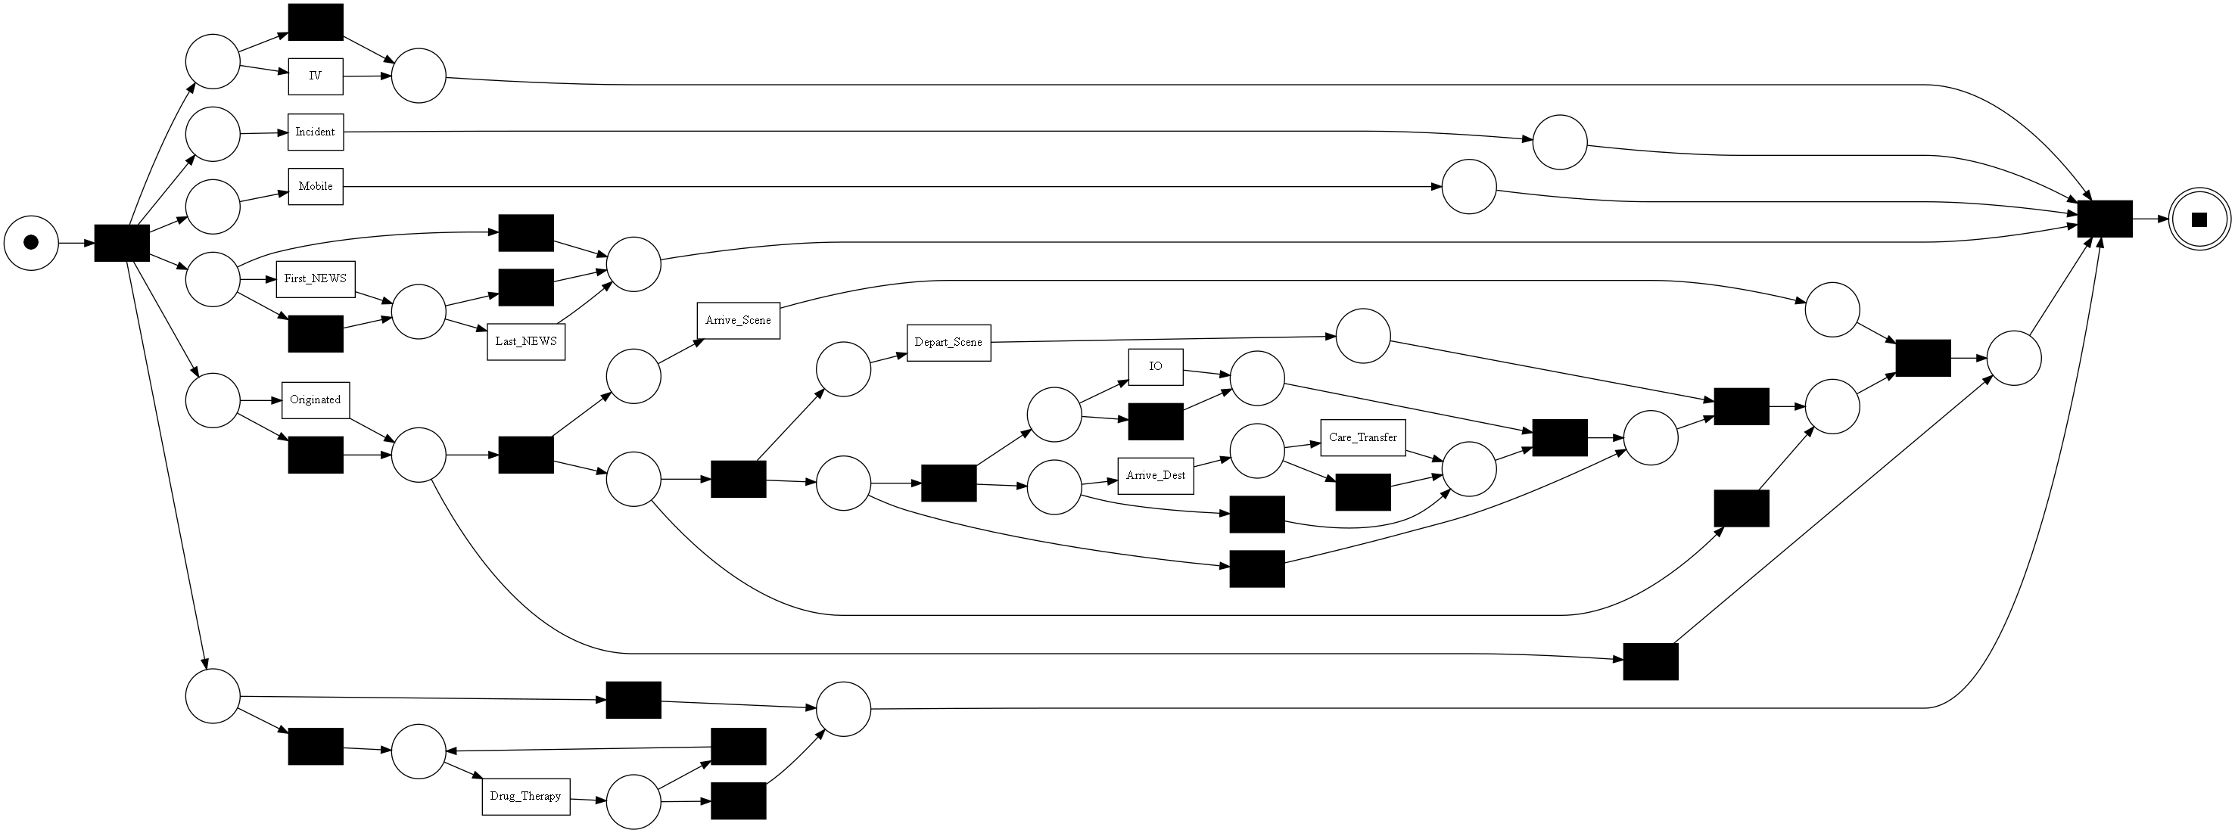
Process Mining Algorithms
A Variety of Process Mining algorithms
Alpha, Heuristic, Inductive, Fuzzy
Each creates a process model in a slightly different way
Some of them focus on optimising specific metrics
A key advantage is easily showing concurrency

Slide 28
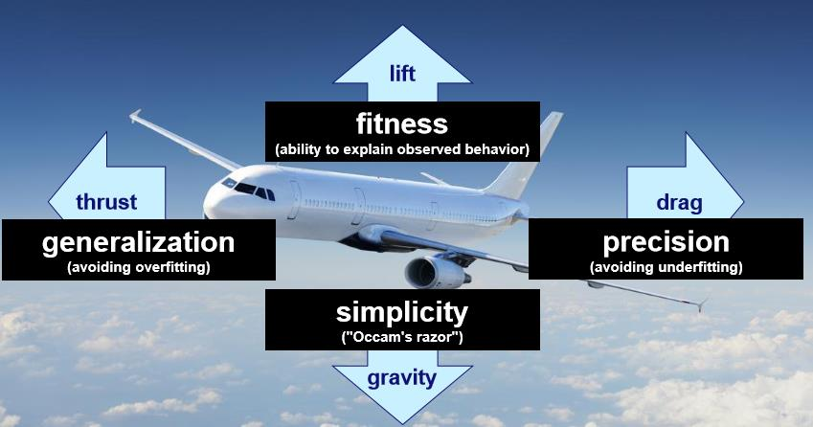
Process Model Metrics

Slide 29
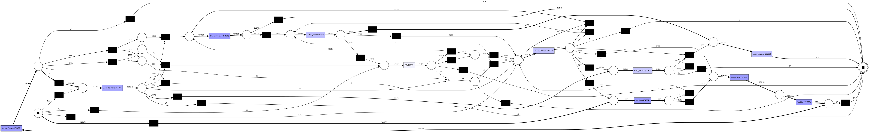
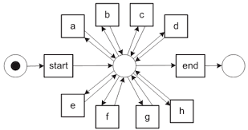
Examples with EMAS
Heuristic Miner
Flower Model
Inductive Miner
Mining Algorithm | Fitness | Precision | Generalisation | Simplicity
Heuristic Miner | 0.91 | 0.96 | 0.87 | 0.53
Inductive Miner | 1. | 0.59 | 0.95 | 0.62

Slide 30
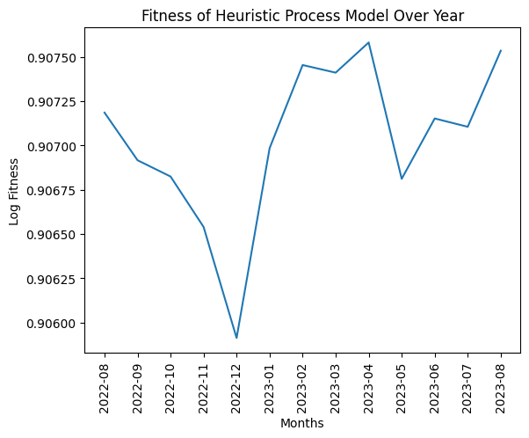
Concept Drift
A years' worth of data
Modelled with Heuristic miner
Infrequent Sequences are not featured resulting in lower fitness when they occur

Slide 31
Enhancements -Machine Learning Application and Analysis
Predicting Outcome
Filter by Clinical Category
Boxplots for events and Attributes of interest.
Predicting time of Job Cycle

Slide 32
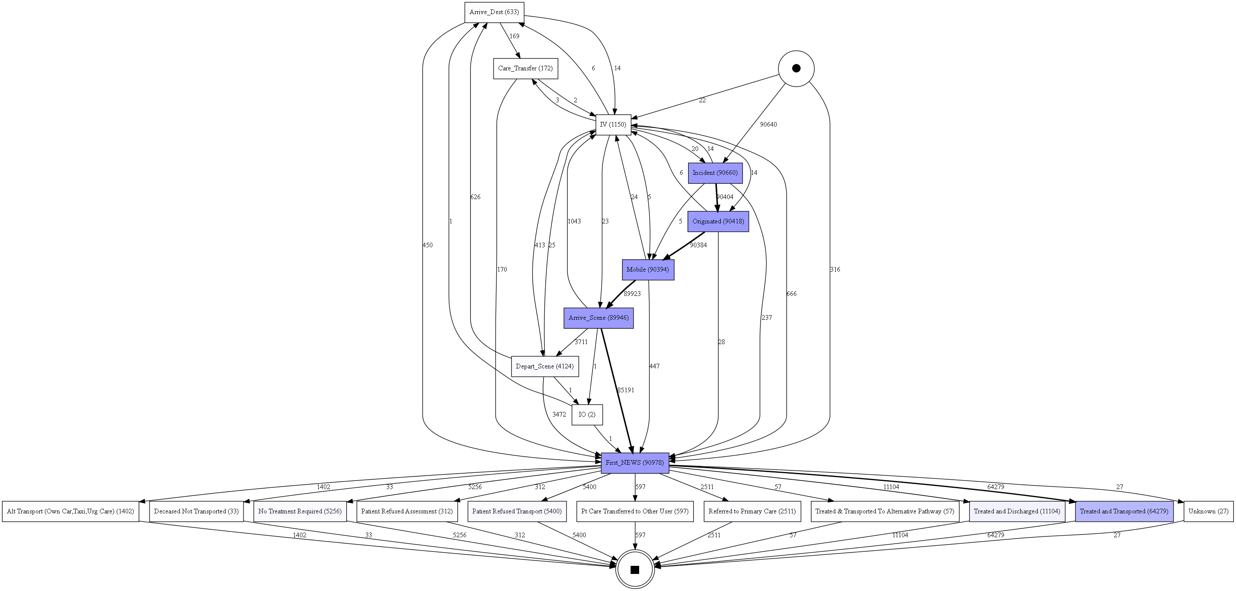
Predicting Outcome
We wish to predict outcome of a patient at a meaningful point in time ahead of when the outcome might already be expected.
Predict from Arrive On Scene First NEWS etc
Only use features available up to this final Event.

Slide 33
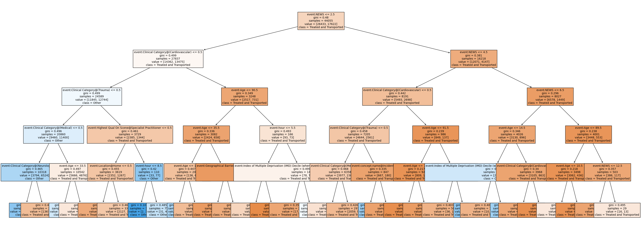
Modelling - Decision Tree
Random Forest, Decision Tree and Logistic Regression applied
Class imbalance with Treated and Transported
Under sampled and grouped other classes into an umbrella class
Still overfits to predicting Treated and Transported which accuracy scores reflecting the ratio of Treated and Transported in the test set.
Example Decision Tree

Slide 34
Feature Importance
Decision Tree |  | Random Forest
Feature | Importance | Feature | Importance
NEWS | 0.211397 | NEWS | 0.290323
Age | 0.152235 | Clinical Category@(Cardiovascular) | 0.121883
hour | 0.090149 | Age | 0.107600
Clinical Category@(Cardiovascular) | 0.081912 | hour | 0.058150
Clinical Category@(Neurological) | 0.081590 | Clinical Category@(Trauma) | 0.048782
Geographical Barriers Sub-domain Decile ... | 0.063383 | Clinical Category@(Medical) | 0.048573
Clinical Category@(Medical) | 0.051616 | Clinical Category@(Neurological) | 0.042213
Health Deprivation and Disability Decile | 0.047270 | Geographical Barriers Sub-domain Decile | 0.040932
Index of Multiple Deprivation (IMD) Decile | 0.044883 | Health Deprivation and Disability Decile | 0.038586
Clinical Category@(Trauma) | 0.037598 | Index of Multiple Deprivation (IMD) Deci... | 0.037952
Clinical Category@(Respiratory) | 0.012627 | Clinical Category@(Respiratory) | 0.022134
Gender@Male | 0.010841 | Clinical Category@(Mental Health) | 0.020244
Highest Qual On Scene@Paramedic | 0.010377 | Gender@Female | 0.009345

Slide 35
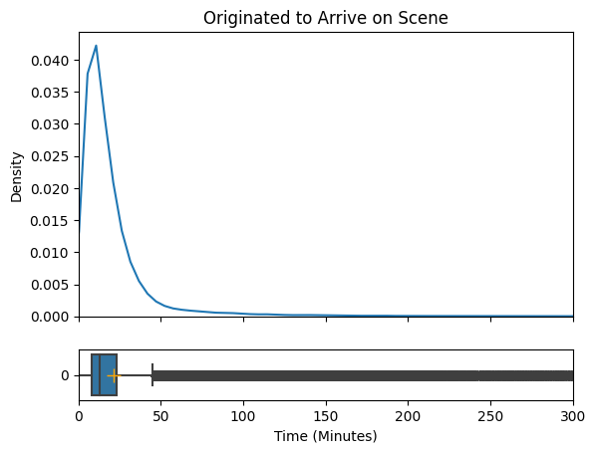
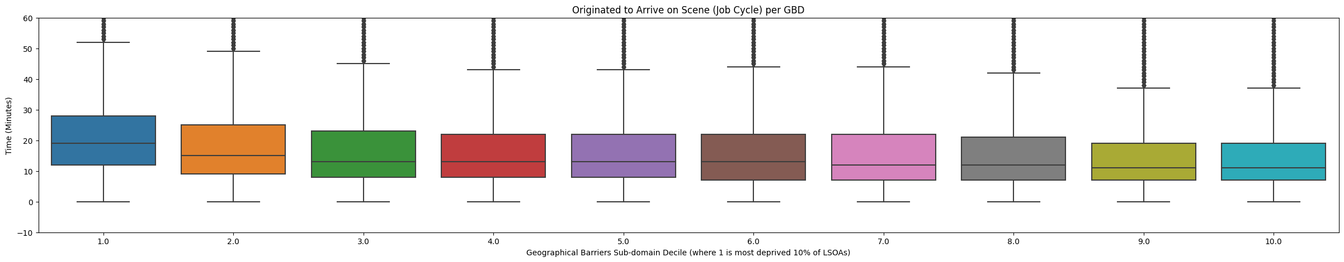
Analysis – Originated to Arrive on Scene
Geographical Barriers Sub-domain Decile (where 1 is most deprived 10% of LSOAs) | Mean effect on mean time between Originated and Arrive_Scene (minutes)
1.0 | 5.023854
2.0 | 2.192652
4.0 | 0.193038
5.0 | -0.075468
3.0 | -0.166668
6.0 | -0.741765
7.0 | -0.810292
8.0 | -1.267654
9.0 | -2.203978
10.0 | -2.50260

Slide 36
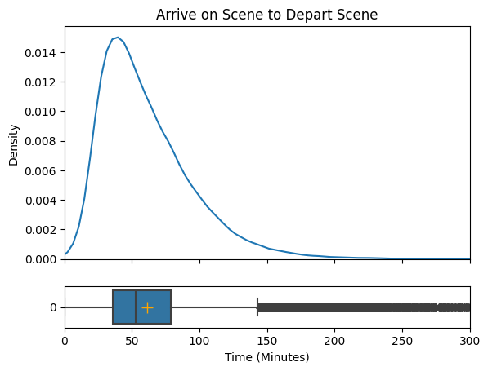
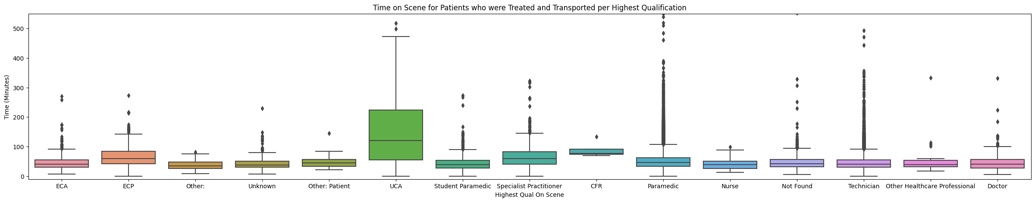
Analysis – Ambulance Arrive on Scene to Ambulance Depart Scene (Time on Scene)
Highest Qualification on Scene | Mean effect on mean time between Arrive_Scene and Depart_Scene (minutes)
UCA | 97.898471
Specialist Practitioner | 14.543051
CFR | 13.455614
ECP | 13.385187
Other Healthcare Professional | 12.691063
Paramedic | 1.229887
Other: Patient | 0.021548
Technician | -3.018392
Not Found | -3.385350
ECA | -4.630408
Student Paramedic | -4.964899
Unknown | -6.251133
Nurse | -8.452377
Doctor | -10.980780
Other: | -13.479307

Slide 37
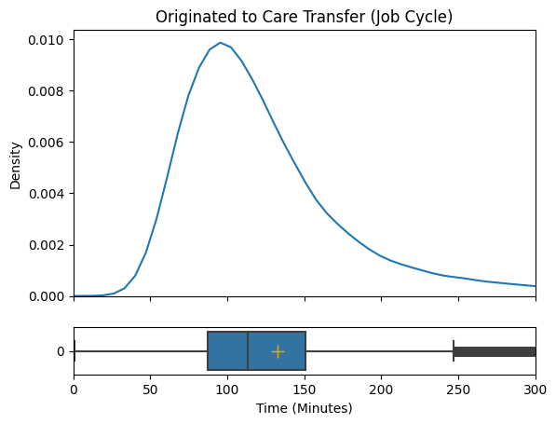
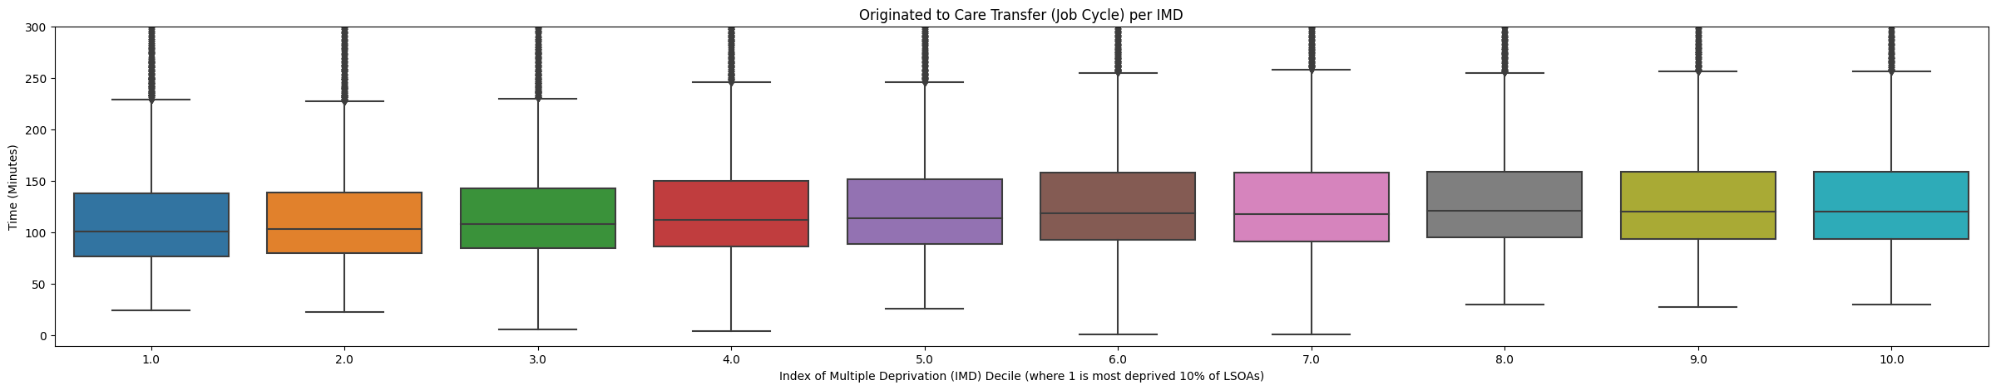
Analysis – Call Originated to Care Transfer (Job Cycle)
Index of Multiple Deprivation (IMD) Decile | Mean effect on mean time between Originated and Care_Transfer (minutes)
10.0 | 8.622368
8.0 | 8.544051
9.0 | 8.306302
6.0 | 7.087109
7.0 | 6.073256
5.0 | 1.558553
4.0 | -0.039919
3.0 | -5.421739
2.0 | -10.883210
1.0 | -11.588523

Slide 38
Project Outputs
EMAS
Process Mining Algorithms
Concept Drift

Slide 39
EMAS
Findings
Observed bottlenecks at crew allocation and handover. However, these bottlenecks were observed to affect the time spent on scene.
Measured the effect of different attributes on the response time, time spent on scene and handover time. (Highest Qualification on Screen, Clinical Safety Plan Level, Index of Multiple Deprivation).
Tried to predict whether a patient was to transported to hospital. More data required to do this accurately.
Future work
Add outcomes from A&E to observe how attributes in the job cycle effect patent survival
Produce a model to simulate how different attributes effect an ambulance job cycle
Provided a case study of the use of their data with ideas on where to take it forward

Slide 40
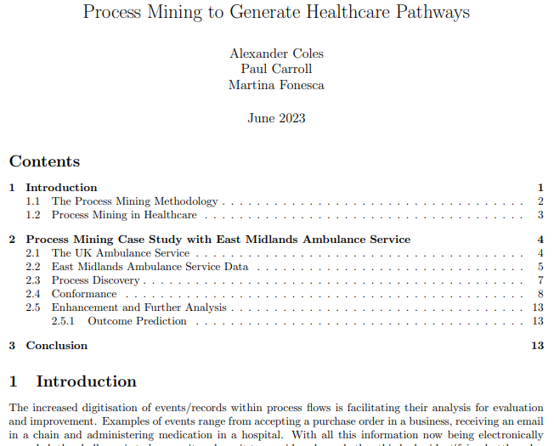
Report
Report available
Includes an overview of PM in healthcare, the PM2 process pathway and the case study on EMAS data

Slide 41
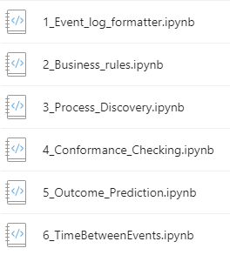
Github Repo
Notebook to follow in order
The data for the notebooks is fake data made to look like ambulance data.
Attributes won’t have relation to each other, so although the code will run, the findings won’t be the same as what you haves seen in these presentations.

Slide 42
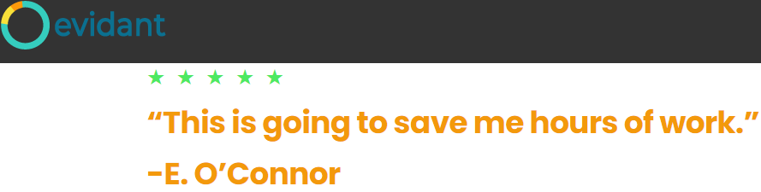
Recommendations
What are your outcomes for the process? What is a good or bad outcome?
Evaluate availability of data and the feasibility of turning it into an event log.
What attributes can you attach to the event log to “enhance” the event log (Resource performing the activity etc)?

